Slide 1

AIKTC – Anjuman-I-Islam’s Kalsekar Technical Campus. Department of Computer Engineering
SE Mini Project-1A
Presentation 1
On
ADVENTURE BALL GAME
By
Roll No. Name of Students
23DS30 DULDULE USAID SAAD
23DS41 KOHARI AAKIF ASIF
23DS23 ANSARI TABEER ASAD TANVEER
23DS49 RAIS MOHD NOOH MUJEEB
Guided by
PROF SAFIA SADRUDDIN

Slide 2
Outline
Introduction
Problem statement
System Design and Architecture
Proposed Methodology/ Techniques
Implementation Details
Future updates
Conclusion
References
A.I. Kalsekar Technical Campus, New Panvel.

Slide 3
Introduction
The points to be covered under Introduction section are:
Motivation: We drew motivation from classic platformers like Super Mario B., incorporating elements like challenging levels and rewarding gameplay.
Objectives: Our primary objective was to create a fun and engaging game that showcases our understanding of game development principles and utilizes advanced programming techniques.
A.I. Kalsekar Technical Campus, New Panvel.

Slide 4
Problem Statement
Making of a 2D platformer game using java GUI framework
A.I. Kalsekar Technical Campus, New Panvel.

Slide 5
System Design and Architecture
We are made the graphics of the game in pixelated style Using a website :
https://www.pixilart.com/
We have divided our game into multiple packages and classes based on entities, gamestate, main, levelsWe have used java libraries like swing, awt, etc.For example, JFrame class from swing is used to create a basic frame.KeyboardListener and MouseListener from awt library is used to take input from user.
A.I. Kalsekar Technical Campus, New Panvel.

Slide 6

Proposed Methodology /Techniques
.The game features a bouncy ball character navigating challenging levels filled with obstacles, enemies, and collectible items like “COINS”.
. We have used an array of BufferedImage to load the basic 7 tiles used to design our game. Then we have created a basic image where every pixel correspond to a certain RGB value.And according to this value we load the level's tiles
.For animations according to the user inputs the ball's character iterates through an array of images giving the effect of an animation
A.I. Kalsekar Technical Campus, New Panvel.

Slide 7
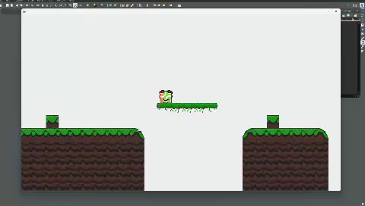
Implementation Details
Describe the Technologies and Tools along with
Software Tools: We are developing a game using the Java programming language within the Eclipse Integrated Development Environment (IDE). Eclipse provides a robust set of tools and features that facilitate coding, debugging, and testing, making it an ideal choice for game development projects.
Demonstration:
A.I. Kalsekar Technical Campus, New Panvel.

Slide 8
FUTURE UPDATES
incorporating features such as coins, obstacles, time limits, and scores into our 2D platform adventure game presents several limitations. First, the addition of numerous collectible coins and intricate obstacles could potentially affect game performance, leading to slower load times or reduced frame rates on lower-end devices. Managing time constraints might also introduce stress, potentially impacting the player’s enjoyment and making the game less accessible for casual players. Furthermore, implementing a dynamic scoring system requires careful balancing to ensure fairness and prevent exploits, which can be challenging given the need to accommodate varying levels of player skill. Addressing these limitations will be crucial to maintaining a smooth, enjoyable gameplay experience while ensuring the game remains engaging and balanced.
A.I. Kalsekar Technical Campus, New Panvel.

Slide 9
Conclusion
We are developing a 2D platform adventure game in Java using the Eclipse IDE.Our project involves developing a 2D platformer game in Java within the Eclipse IDE. Players guide a bouncy ball through intricate levels packed with obstacles, enemies, and coins to collect. The game’s controls are intuitive: use the spacebar to jump and "D" or "A" to roll forward and backward, respectively. With physics-driven movement and interactive gameplay elements, the game offers diverse levels, a dashing move, a BAT for combat, and a scoring system to track achievements.
A.I. Kalsekar Technical Campus, New Panvel.

Slide 10
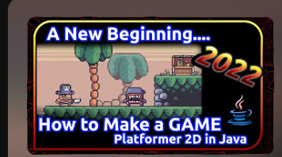
References
https://www.youtube.com/playlist?list=PL4rzdwizLaxYmltJQRjq18a9gsSyEQQ-0
A.I. Kalsekar Technical Campus, New Panvel.

Slide 11
Thank You
A.I. Kalsekar Technical Campus, New Panvel.
Notes:
In Slide Show mode, select the arrows to visit links.

